Slide 1

Potential Energy Storage: Case Study on Decommissioned Mines
Prepared by
Jacob Rivelis
Ridley Horton
Connor Button
Toby Holland
Presented to:
QUESST Judging Panel

Slide 2

Nigeria and Blackout Statistics
Nigeria is Africa’s largest economy and country
220m people
$550B GDP
Mining Sector 10% of GDP by 2030
85% Electrification with Continuous Blackouts
4500-6000 hours of outage annually (150-250 days)
5% GDP, $29B loss annually
80% businesses spend on diesel to offset the blackouts
Diesel electricity cost: $0.40–$0.75/kWh (SDG
16.5Mt CO2 annually
Blackouts harming safety
74% of households report outages as a major threat to water, food, and medical security
93% of households throw out spoiled food during blackouts

Slide 3
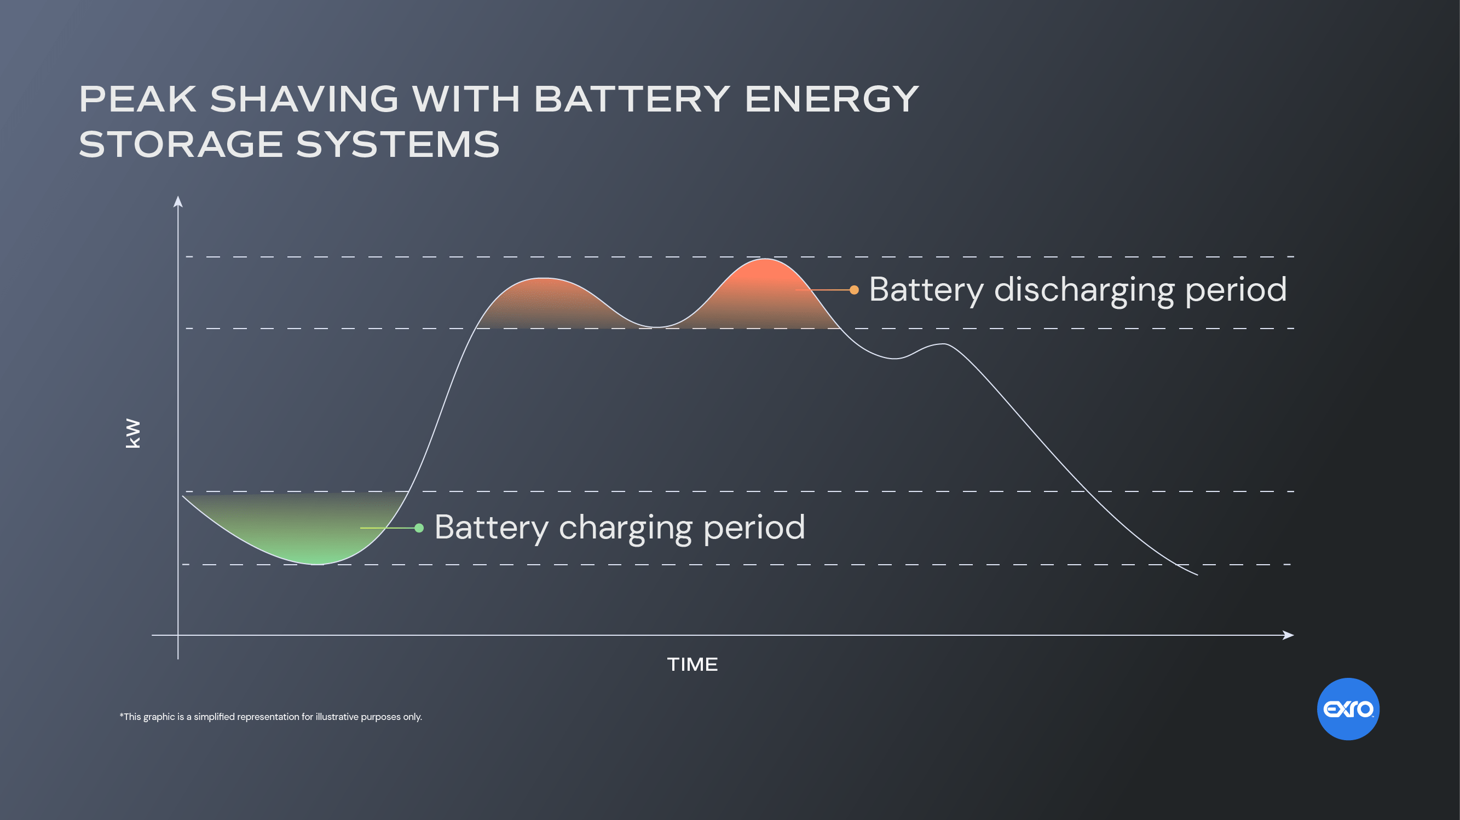
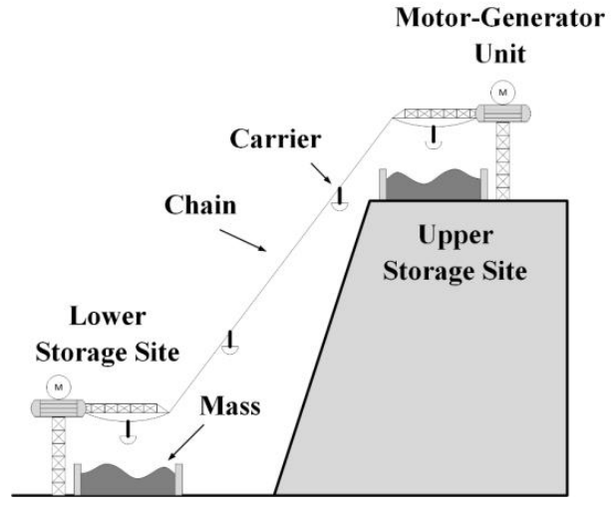
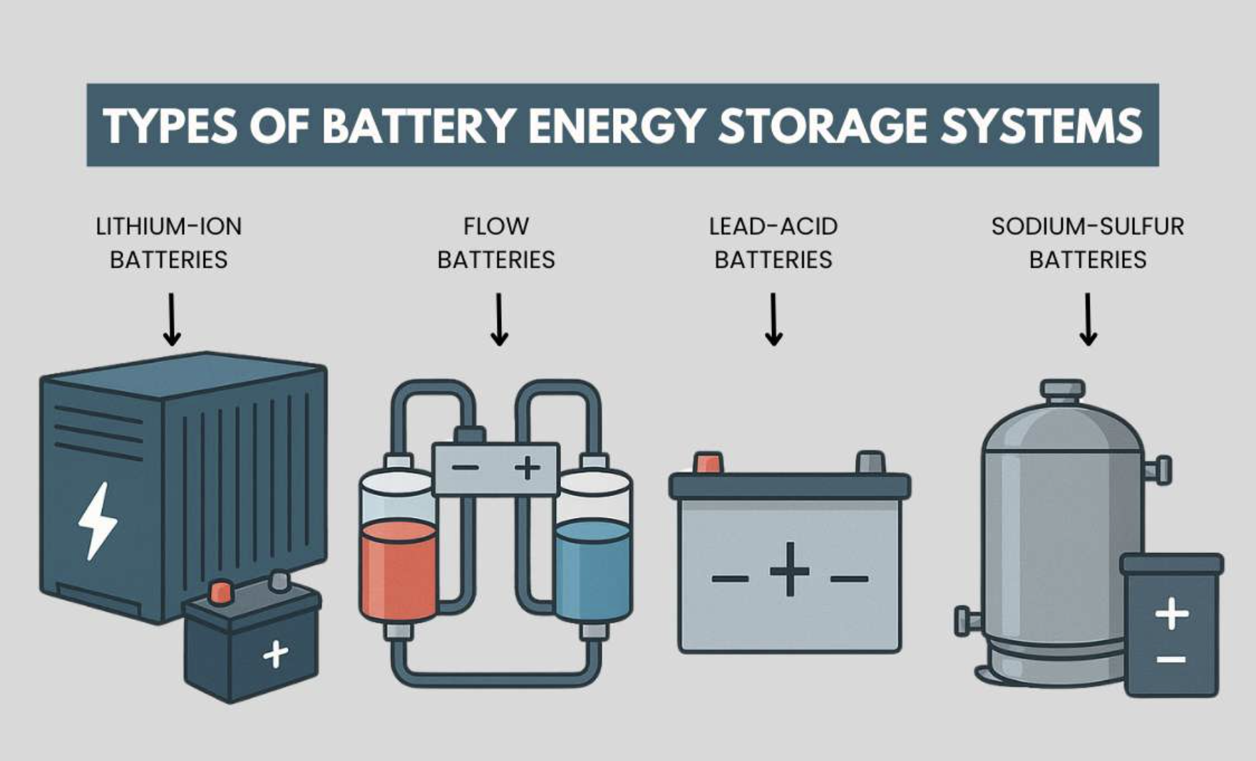
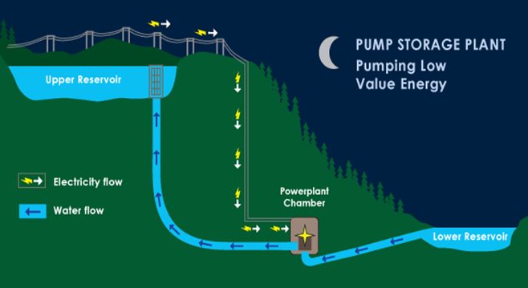
Blackout Solution - Energy Storage
Lagos, Nigeria peak demand: 4,000 MW
Supply: 2,000 MW
Deficit (over 4 peak hours): 16,000 MWh
Gravity Storage
Pumped Hydro Storage
Chemical Energy Storage

Slide 4
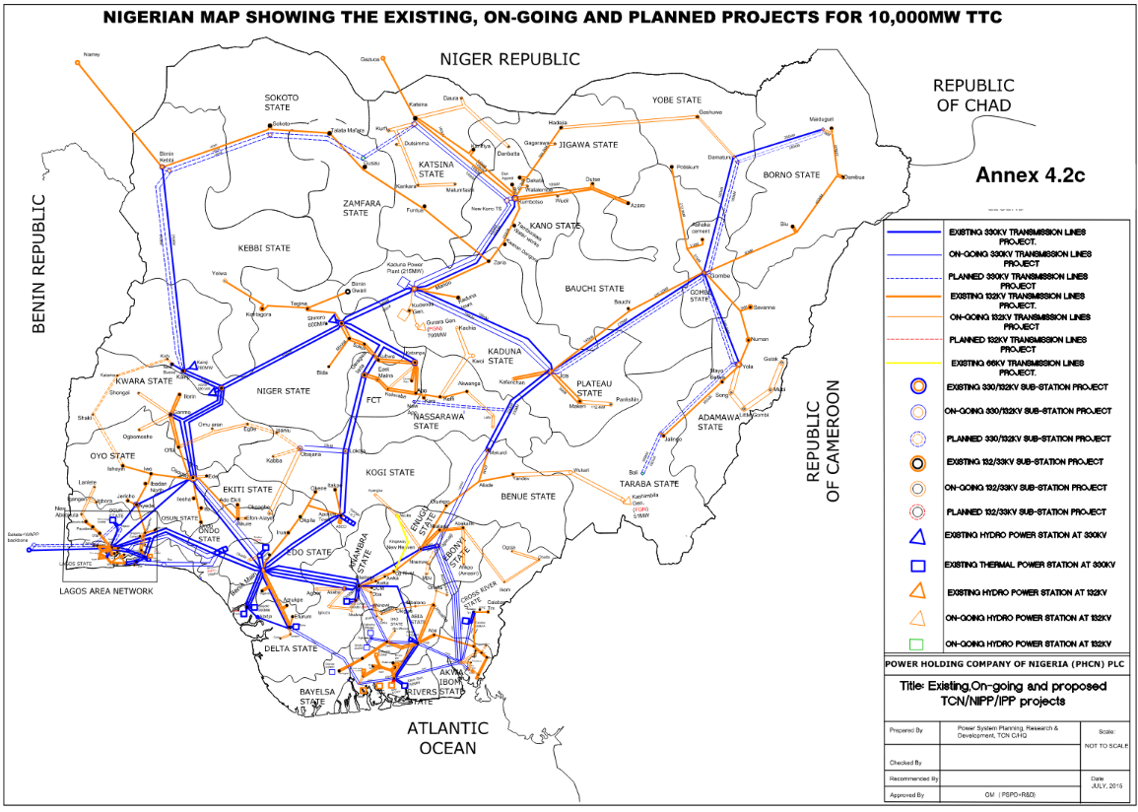
Nigeria Solution Implementation
Size of Project
7 Decommissioned Pit Mines
100 Tracks
Costs and Savings
$800 Million Upfront Costs
$20 Million Annual Costs
1 GWh Capacity
6.25% Blackout Reduction
0.6% GDP Saved ($2.29 Billion Annually)

Slide 5

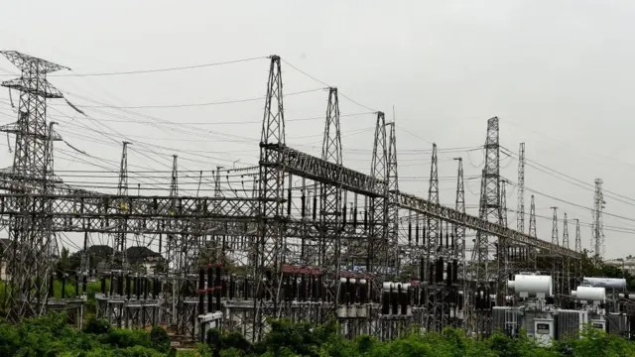

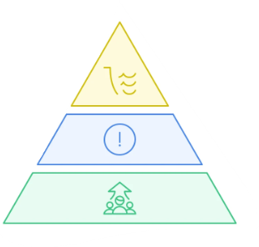
Risks and Implementation
Technical Logistical Regulatory Implementation

Slide 6



Conclusion
Reliable, renewable, and accessible energy
6.25% reduction of daily blackout
$0.58/kWh decrease in price
1Mt CO2/yr saved from diesel generators
Reliable, productive, growing economy
$2.29 Billion in yearly economic recovery
$20 Million in yearly maintenance (11,500 Jobs)
Circulatory growth for mining projects
Quality, reliable, sustainable infrastructure
Water is more consistently treated
Hospitals are open more of the day
Urban life dependent on electricity is stabilized

Slide 7
References
100 m: https://research.ee.sun.ac.za/emr/emr/files/u1/2019-ELSEVIER-Botha.pdf
6 000 MW at peak: https://theelectricityhub.com/lagos-state-targets-4000mw-with-new-gas-power-plant-bids/
200 days of blackouts, Annual GDP Losses: https://journalwjaets.com/sites/default/files/fulltext_pdf/WJAETS-2025-0900.pdf
Solid Gravity: https://www.researchgate.net/publication/361785221_Solid_Gravity_Energy_Storage_A_review
https://power.nridigital.com/power_technology_mar19/tower_of_power_gravity_based_storage_evolves_beyond_pumped_hydro

Slide 8
Appendix
Criteria | Metrics | Lithium-Ion Battery Storage | Hydro Pumped Storage | Solid Gravity Energy Storage
Capacity | 2 | 2 | 5 | 4
O and M Costs | 2 | 2 | 3 | 5
Energy Cost Per kWh | 3 | 1 | 5 | 4
Carbon Footprint | 3 | 2 | 3 | 4
Sustainability | 3 | 3 | 4 | 4
Accessibility | 3 | 5 | 1 | 3
Overall Score |  | 41 | 55 | 63

